Slide 1
Introduction to Metabolism
Metabolism : All the organized chemical activities performed by a cell in which multienzyme systems co-operate.
Metabolism comprise four specific functions :
To obtain chemical energy from fuel molecule or from absorbed sunlight.
To convert exogenous nutrients in to building blocks or precursors of macromolecules.
To assemble such building blocks in to Proteins, N. Acids, Lipids & other cell components.
To form & degrade bimolecules required for specialized functions of cell.
The Metabolic reactions are categorized as :
1. Catabolism
2. Anabolism
3. Primary Metabolism

Slide 3
4. Secondary Metabolism
5. Intermediary Metabolism
Catabolism :
- Biochemical reactions which involves degradation of large & complex molecules to yield small- simple molecules.
- Products of catabolism are called catabolites.
- Release of chemical energy in form of ATP.
- Involves Oxidative reaction: NAD⁺→ NADH + H⁺ (generates reducing power).
Anabolism :
- Biochemical reactions which involves biosynthesis of cellular molecules.
- Includes Biosynthesis of :
1. Building blocks of cellular macromolecules.
2. Vitamins & Co-enzymes

Slide 5
3. Cellular macromolecules such as Proteins, N. Acids, Lipids & other cell components.
- Requires chemical energy – furnished by ATP generated during catabolism.
- Involves Reductive reaction: NADH + H⁺→ NAD
- Catabolism & Anabolism takes place simultaneously in cells but they are independently regulated.
Relation between Anabolism & catabolism :
1. On that of carbon sources – the product of catabolism becomes the substrate for anabolism.
2. On that of Energy supply - Catabolism produces energy(ATP). Anabolism utilizes energy.
3. On that of Reducing power - Catabolism produces reducing power, reverse is for anabolism.

Slide 7
Catabolic and Anabolic pathways between a given precursors & a given products are not reverse to each other e.g. Degradation of glycogen to Lactic acid - 12 steps. While biosynthesis involve 9 steps.
Catabolic and Anabolic pathways takes place in different location e.g. Oxidation of fatty acids takes place in mitochondria where as biosynthesis takes place in cytosol.
Three stages of Catabolic and Anabolic pathways :
Proteins Polysaccharides Lipids
Stage: I ↓↑ ↓↑ ↓↑
Amino acids Hexoses & Fatty acids
Pentoses Glycerols
Stage: II ↓↑ ↓↑ ↓↑
Acetyl CoA Acetyl CoA Acetyl CoA
↓↑ Stage: III ↓↑ ↓↑
Co2 + Water

Slide 9
Primary Metabolism : The part of cellular metabolism which is very much essential for cell growth is termed as Primary metabolism and the products are called primary metabolites.
Products includes : 1. Energy rich compounds such as ATP.
2. Organic acids such as lactic acid, citric acid etc.
3. Organic alcohols and solvents such as ethanol, glycerol Acetone , Butanol etc.
4. Aminoacids, Vitamins, Co- enzymes, Nucleotides etc.
- Operative in the cell during Log phase of growth.
Secondary Metabolism : The part of cellular metabolism which is not essential for cell growth is termed as Secondary metabolism and the products are called Secondary metabolites. Active during late log phase and stationary phase of growth. E.g. Antibiotic synthesis.
Intermediary Metabolism : The part of cellular metabolism which occurs after the entry of nutrients in to the cell, leading to the synthesis of building blocks of the cellular macromolecules is referred as Intermediary Metabolism.

Slide 11
Methods of studying Biosynthesis :
Use of Biochemical Mutants :
- Important tool for the study of biosynthesis after G. Beadle & E.
Tatum (1940) isolated auxotrophic mutants.
- Mutants require growth factors that the parental strain can synthesize.
- Requirements are caused by genetic loss of the ability to synthesize the growth factor.
- One gene one protein (enzyme) hypothesis – each individual enzyme is encoded by a specific gene.
- Biochemical Mutants can be utilized to determine the sequence of reactions in a biosynthetic pathways by following ways :
1. By determining the number of different genes that undergo mutation resulting in a nutritional requirement for the same growth factor, the no. of different enzymatically catalyzed reaction in biosynthetic pathway of that growth factor can be determined.

Slide 13
e.g. mutations in eight different genes leads to the requirement of Arginine amino acid , suggesting that eight enzymatically catalyzed reactions in Arginine pathway.
Glutamic acid
↓arg A
N- acetyl glutamic acid
↓ arg B
↓ arg C
↓ arg D
↓ arg E
Ornithine
↓ arg F
Citrulline
↓ arg G
Arginino succinic acid
↓ arg H
Arginine

Slide 14
2. Genetic blockage in a pathway tend to accumulate & excrete the metabolic intermediate prior to the blockage.
- These intermediate allow the growth of other mutants blocked in the same pathway at an earlier step.
e.g. Strains with mutations in the gene I excrete Ornithine, which is utilized by the strains blocked at earlier steps.
- Intermediate excreted by the mutant strains can be chemically isolated & identified.
3. Information on the sequence of reactions in a biosynthetic pathway can also be obtained by testing the growth response of mutant strains to suspected intermediates of the pathway.
e.g. An arg I mutant will grow if arginine or citrulline is added to the medium. An arg A strain will grow if arginine, citrulline or ornithine is added.
- indicate citrulline & ornithine appear to be intermediates of the arginine pathway with ornithine being a precursor of citrulline.

Slide 15
Use of Isotopic Labeling :
- Exogenous compound is labeled with radioisotope.
- Chemical fractionation of labeled cells can revel the ultimate location of radioactivity in the various cell constituents.
- e.g. C14 - labeled glutamic acid is incorporated in to protein , not only as glutamic acid residues but also as residues of arginine and proline means glutamic acid is a biosynthetic precursor of arginine and proline .
  Another technique employing a radioisotopes is Pulse labeling.
  -

Slide 16
Respiration :
- In Higher organisms Respiration is defined as intake of O2 and release of CO2 .
- In bacteria it is a oxidation of metabolites, resulting in release of energy.
- ATP is generated by three main mechanism :
1. Respiration - Aerobic & Anaerobic respiration
2. Fermentation
3. Photosynthesis
Donor Acceptor Donor
Aerobic Respiration Organic → O2 → Inorganic
Anaerobic Respiration Organic → Inorganic → Inorganic
Fermentation Organic → organic
- In Respiration primary ē donor is oxidizable substrate and
terminal ē acceptor is an inorganic compound either O2 (aerobic) or
No3, SO4 or CO3 (anaerobic).

Slide 18
In eukaryotic cells Electron Transport Chain (ETC) & Oxidative Phosphorylation occurs in Mitochondria.
- The role of mitochondria in O2 uptake or respiration was demonstrated by Otto Warburg in 1913.
- In 1948 by E. Kennedy and Albert Lehninger showed that mitochondria are the site of oxidative phosphorylation in eukaryotes.
- The inner membrane bears the components of the respiratory chain and the ATP synthase.
- In Bacteria, the plasma membrane plays the same role as inner membrane of mitochondria.
Electron Transport Chain (ETC) :
ETC of Mitochondria contains large number of electron carrying proteins that acts in sequence to transfer the electrons from reduced substrates to O2.

Slide 20
Electron carrying proteins includes :
1. Nicotinamide nucleotides(NAD⁺ or NADP⁺)
2. Flavin nucleotides (FMN or FAD)
3. Ubiquinone or Coenzyme-Q
4. Cytochromes
5. Iron-sulfur proteins
1. Nicotinamide nucleotides(NAD⁺ or NADP⁺) :
- Most of the electron pairs enters ETC arise from the action of dehydrogenases utilizes NAD⁺ or NADP⁺ as ē acceptors.
- Nicotinamide nucleotides linked dehydrogenases catalyze reversible reaction as follows:
Reduced substrate + NAD⁺ ↔ Oxidized substrate + NADH + H⁺
Reduced substrate + NADP⁺ ↔ Oxidized substrate + NADPH + H⁺
- Most dehydrogenases are specific for NAD⁺ as ē acceptors.
- Some are in the cytosol, others are in mitochondria, and still others have mitochondrial and cytosolic isozymes.

Slide 22
- NAD-linked dehydrogenases remove two hydrogen atoms from their substrates.
- One of these is transferred as a hydride ion (:H) to NAD; the other is released as H⁺ in the medium.
- NADH and NADPH are water-soluble electron carriers that associate
reversibly with dehydrogenases.
- NADH carries electrons from catabolic reactions.
- NADPH generally supplies electrons to anabolic reactions.
2. Flavoproteins :
- Flavoproteins are the enzyme with a yellow colored prosthetic group derived from vitamin Riboflavin.
- The prosthetic groups are FMN or FAD. Both possess same active site capable of undergoing reversible Oxidation & Reduction.
- The oxidized flavin nucleotide can accept either one electron (yielding the semiquinone form) or two (yielding FADH2 or FMNH2).
- Flavoproteins can participate in either one- or two-electron transfers . They serve as Intermediate between two reactions in which two ē are donated and in which one ē is accepted.

Slide 23
3. Ubiquinone or Coenzyme-Q :
Ubiquinone (coenzyme Q) is a lipid-soluble benzoquinone with a long isoprenoid side chain.
- closely related compounds plastoquinone (of plant chloroplasts) and menaquinone (of bacteria).
- Ubiquinone can accept one electron to become the semiquinone radical (QH) or two electrons to form ubiquinol (QH2).
- it can act at the junction between a two-electron donor and a one-electron acceptor.
- Because ubiquinone is both small and hydrophobic, it is freely diffusible within the lipid bilayer of the inner mitochondrial membrane.
- Carries both electrons and protons, it plays a central role in coupling electron flow to proton movement.

Slide 25
4. Cytochrome :
The cytochromes are proteins with characteristic strong absorption of visible light, due to their iron containing heme prosthetic groups .
- Mitochondria contain three classes of cytochromes, designated a, b, c - distinguished by differences in their light-absorption spectra. - Each type of cytochrome in its reduced (Fe⁺2 ) state has three absorption bands in the visible range.
- near 600 nm in type a cytochromes, near 560 nm in type b, and near 550 nm in type c.
- Cytochromes were first discovered & called histohematins in 1866 by C.MacMunn.
- All cytochromes undergo reversible Fe⁺2 to Fe⁺3 valance change
- The heme cofactors of a and b cytochromes are tightly, but not covalently, bound to their associated proteins; while the hemes of c-type cytochromes are covalently attached through Cys residues.

Slide 27
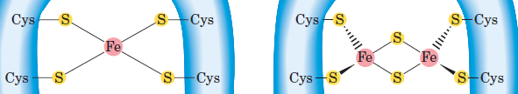
5. Iron-sulfur proteins :
Iron-sulfur proteins ,first discovered by Helmut Beinert.
- The iron is present in association with inorganic sulfur atoms or with the sulfur atoms of Cys residues in the protein, or both.
- These iron-sulfur (Fe-S) centers range from simple structures with a single Fe atom coordinated to four Cys -SH groups to more complex Fe-S centers with two or four Fe atoms .

Slide 28
Rieske iron-sulfur proteins (named after their discoverer,
John S. Rieske) are a variation in which one Fe atom is coordinated to two His residues rather than two Cys residues.
- All iron-sulfur proteins participate in one-electron transfers in which one iron atom of the iron-sulfur cluster is oxidized or reduced.
- At least eight Fe-S proteins function in mitochondrial electron transfer.
The overall reaction catalyzed by the mitochondrial respiratory chain,where electrons move from NADH, succinate,or some other primary electron donor through flavoproteins, ubiquinone, iron-sulfur proteins, and cytochromes,and finally to O2.

Slide 29
Electron Transport Chain
Ketoglurate
Malate ↘
↘
Pyruvate → NAD → FP → Fe-s → CO-Q → Cyt-b → → Cyt-c1
Isocitrate ↗ ↑
Glutamate ↗ FP
↑ Succinate
Fatty acyl -CoA
→ Cyt-c → Cyt-aa3 → O2

Slide 30
Electron Carriers Complexes :
- The electron carriers of the respiratory chain are organized
Into four unique complexes.
- Complexes I and II catalyze electron transfer to ubiquinone from two different electron donors: NADH (Complex I) and succinate (Complex II).
- Complex III carries electrons from reduced ubiquinone to cytochrome- c.
- Complex IV completes the sequence by transferring electrons from cytochrome -c to O2.
Complex I: NADH to Ubiquinone :
Complex I, also called NADH:ubiquinone oxidoreductase or NADH dehydrogenase, is a large enzyme composed of 42 different polypeptide chains, including an FMN-containing flavoprotein and at least six ironsulfur centers.
- Complex I catalyzes two simultaneous and obligately coupled processes:

Slide 31
(1) the exergonic transfer to ubiquinone of a hydride ion from
NADH and a proton from the matrix,
NADH + H⁺ + Q → NAD⁺ + QH2
(2) the endergonic transfer of four protons from the matrix to the intermembrane space.
- Complex I is therefore a proton pump driven by the energy of electron transfer, and the reaction it catalyzes is vectorial.
- Amytal (a barbiturate drug), Rotenone (a plant product commonly used as an insecticide), and Piericidin A (an antibiotic) inhibit electron flow from the Fe-S centers of Complex I to ubiquinone and therefore block the overall process of oxidative phosphorylation.
- Ubiquinol (QH2, the fully reduced form) diffuses in the inner mitochondrial membrane from Complex I to Complex III, where it is oxidized to Q in a process that also involves the outward movement of H⁺.

Slide 32
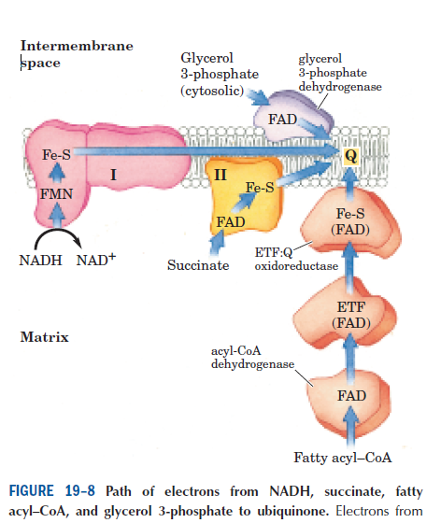

Slide 33
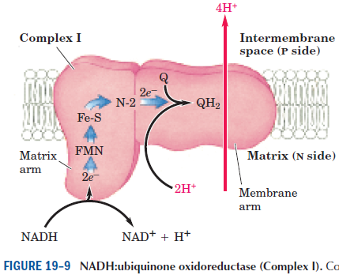

Slide 34
Complex - II: Succinate to Ubiquinone :
Complex - II is smaller and simpler than Complex I, it contains five prosthetic groups of two types and four different protein subunits.
- Subunits C and D are integral membrane proteins. They contain a heme group, heme b, and a binding site for ubiquinone.
- Subunits A and B extend into the matrix . They contain three 2Fe-2S
centers, bound FAD, and a binding site for the substrate succinate.
- The path of electron transfer from thesuccinate-binding site to FAD, then through the Fe-S centers to the Q-binding site.
Complex - III: Ubiquinone to Cytochrome – c
Complex - III, also called cytochrome bc1 complex or ubiquinone:cytochrome c oxidoreductase, couples the transfer of electrons from ubiquinol (QH2) to cytochrome- c with the vectorial
transport of protons from the matrix to the intermembrane space.
The net equation of Q cycle is :
QH2 + 2 cyt c1(oxidized) + 2H⁺N → Q + 2 cyt c1(reduced)+ 4H⁺P

Slide 35
Complex – IV : Cytochrome - c to O2
Complex - IV, also called cytochrome oxidase, carries electrons from cytochrome - c to molecular oxygen, reducing it to H2O.
- Complex - IV is a large enzyme (13 subunits; Mr 204,000) of the inner mitochondrial membrane.
- Bacteria contain a form that is much simpler, with only three or four subunits, but still capable of catalyzing both electron transfer and proton pumping.
- Mitochondrial subunit II contains two Cu ions complexed with - SH groups of two Cys residues in a binuclear center that resembles the
2Fe-2S centers of iron-sulfur proteins.
- Subunit -I contains two heme groups, designated a and a3, and another copper ion (CuB). Heme a3 and CuB form a second binuclear center that accepts electrons from heme a and transfers them to O2 bound to heme a3.
- Electron transfer through Complex IV is :
Cytochrome –c → CuA center → heme - a → heme a3–CuB center → O2 .

Slide 36
- For every four electrons passing through this complex, the enzyme
consumes four “substrate” H from the matrix (N side) in converting O2 to 2H2O. It also pump one proton outward into the intermembrane space (P side) for each electron that passes through.
The overall reaction catalyzed by Complex IV is
4 Cyt c (reduced) + 8H⁺N + O2 → 4 cyt c (oxidized) + 4H⁺P + 2H2O
Much of this energy is used to pump protons out of the matrix.
- For each pair of electrons transferred to O2 - 4 protons are pumped out by Complex-I, 4 by Complex-III and 2 by Complex IV.
The equation for the process is :
NADH + 11H⁺N + ⅟₂ O2 → NAD⁻ + 10H⁺P + H2O
The electrochemical energy due to the difference in proton concentration and separation of charge conserved much of the energy of electron transfer. The energy stored in such a gradient, termed the proton-motive force.

Slide 37
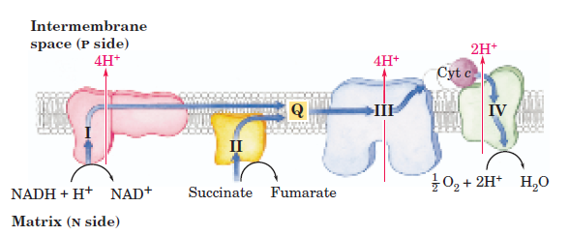
proton-motive force, has two components:
(1) the chemical potential energy due to the difference in concentration of a chemical species (H⁺) in the two regions separated by the membrane.
(2) The electrical potential energy that results from the separation of charge when a proton moves across the membrane.
- The electrochemical energy in the proton gradient drives the synthesis of ATP from ADP and Pi.

Slide 38
Oxidative phosphorylation :
The chemiosmotic model proposed by Peter Mitchell. - According to the model the electrochemical energy inherent in the difference in proton concentration
and separation of charge across the inner mitochondrial membrane—the proton-motive force—drives the synthesis of ATP as protons flow passively back into the matrix through a proton pore associated with ATP synthase.
- Mitchell used “chemiosmotic” to describe enzymatic reactions that involve, simultaneously, a chemical reaction and a transport process.

Slide 39
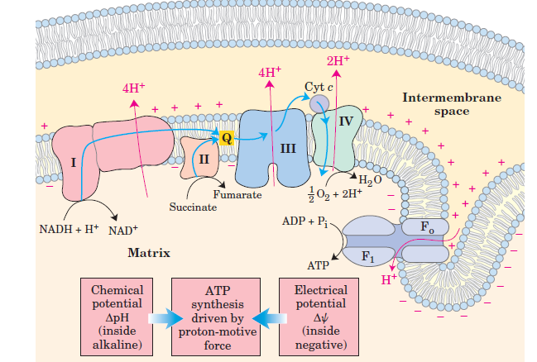

Slide 40
electrons from NADH and other oxidizable substrates pass
through a chain of carriers arranged asymmetrically in the inner membrane.
- Electron flow is accompanied by proton transfer across the membrane, producing both a chemical gradient (pH) and an electrical gradient.
- The inner mitochondrial membrane is impermeable to protons;
- protons can reenter the matrix only through proton-specific channels (Fo).
- The proton-motive force that drives protons back into the matrix provides the energy for ATP synthesis, catalyzed by the F1 complex associated with Fo.

Slide 41
ATP Synthase :
- This large enzyme complex of the inner mitochondrial
membrane catalyzes the formation of ATP from ADP and Pi.
- Also called Complex V, has two distinct components: F1, a peripheral membrane protein, and Fo (o denoting oligomycin-sensitive), which is integral to the membrane.
- F1, was identified and purified by Efraim Racker and his colleagues in the early 1960s.
- Isolated F1 catalyzes ATP hydrolysis (the reversal of synthesis) and was therefore originally called F1ATPase.
- F1 is unstable at 0°c, relatively stable at R.T.
- F1 is a knob like portion, flattened sphere, 8 nm high and 10 nm across, consisting of alternating α and β subunits arranged like the sections of an orange.
- F1 has nine subunits of five different types, with the composition
α3β3γδε. Mol. Wt. – 3,80,000
- Each of the three β subunits has one catalytic site for ATP synthesis.

Slide 42
- the amino acid sequences of the three subunits are identical, their conformations differ.
- β subunit conformations are designated β-ATP, β-ADP, and β-empty.
- γ subunit making up a central shaft that passes through F1.
- The Fo complex - a proton pore is composed of three subunits, a, b, and c, in the proportion ab2c10–12. Subunit c is a small (Mr 8,000),
hydrophobic polypeptide, consisting almost entirely of two transmembrane helices, with a small loop extending from the matrix of the membrane.

Slide 43
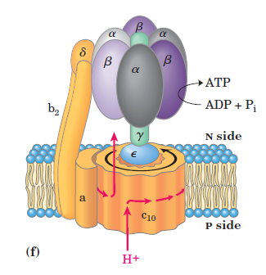

Slide 44
Rotational Catalysis :
- Paul Boyer proposed a Rotational catalysis mechanism in which the three active sites of F1 take turns catalyzing ATP synthesis.
- A given subunit starts in the β-ADP conformation, which binds ADP and Pi.
- The subunit now changes conformation, assuming the - β ATP form.
- Finally, the subunit changes to the β -empty conformation, which has very low affinity for ATP, and the newly synthesized ATP leaves the enzyme surface.
- Another round of catalysis begins when this subunit again assumes the β -ADP form and binds ADP and Pi.

Slide 45
The conformational changes central to this mechanism are driven by the passage of protons through the Fo portion of ATP synthase.
With each rotation of 120, γ comes into contact with a different β subunit, and the contact forces that β subunit into the β -empty conformation.
The three subunits interact in such a way that when one assumes the β-empty conformation, its neighbour to one side must assume the β -ADP form, and the other neighbour the β -ATP form.
One complete rotation of the subunit causes each subunit to cycle through all three of its possible conformations, and for each rotation, three ATP are synthesized and released.

Slide 46
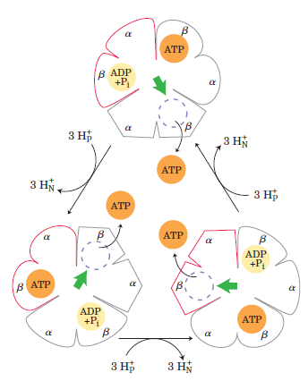

Slide 47
P/O ratio :
- Number of inorganic phosphate molecules taken up to phosphorylate ADP per atom of O2 consumed , and is indicative of the efficiency by which coupling takes place.
- Most experiments have yielded P/O ratios of between 2 and 3 when NADH was the electron donor, and between 1 and 2 when succinate was the donor.
- Number of protons pumped out per pair of electrons are 10 for NADH and 6 for succinate.
- The most widely accepted experimental value for number of protons required to drive the synthesis of an ATP molecule is 4, of which 1 is used in transporting Pi, ATP, and ADP across the mitochondrial membrane.
- If 10 protons are pumped out per NADH and if 4 protons required to produce 1 ATP, the proton-based P/O ratio is 2.5 for NADH as the electron donor and 1.5 (6/4) for succinate.

Slide 48
Fermentation and Substrate level Phosphorylation :
- Fermentation is the simplest mode of ATP generating metabolism.
- Metabolic process in which organic compounds serve both as ē donor and ē acceptor.
- ē are not passed through ETC.
- ē are passed to an oxidized pyridine nucleotide – reducing it. Then donates ē directly to ē acceptor.
- organic compounds that serve both as ē donor and ē acceptor are usually two different metabolites derived from a single substrate.
- Fermentation often gives rise to a mixture of end products– some may be more reduced and some may be more oxidized than the primary substrate.
- Carbohydrates are the principle substrate of fermentation.

Slide 49
- ATP is formed from ADP & Pi from phosphorylated intermediate arise during substrate breakdown – is only possible with fermentation is known as substrate level phosphorylation.
- Organisms that obtain energy by fermentation are strict anaerobes.
- Pyridine nucleotides reduced in one step of fermentation are oxidized in another.
- Two molecules of NAD⁺ reduced are reoxidized by reactions involving the subsequent metabolism of pyruvic acid.
Fig :

Slide 50
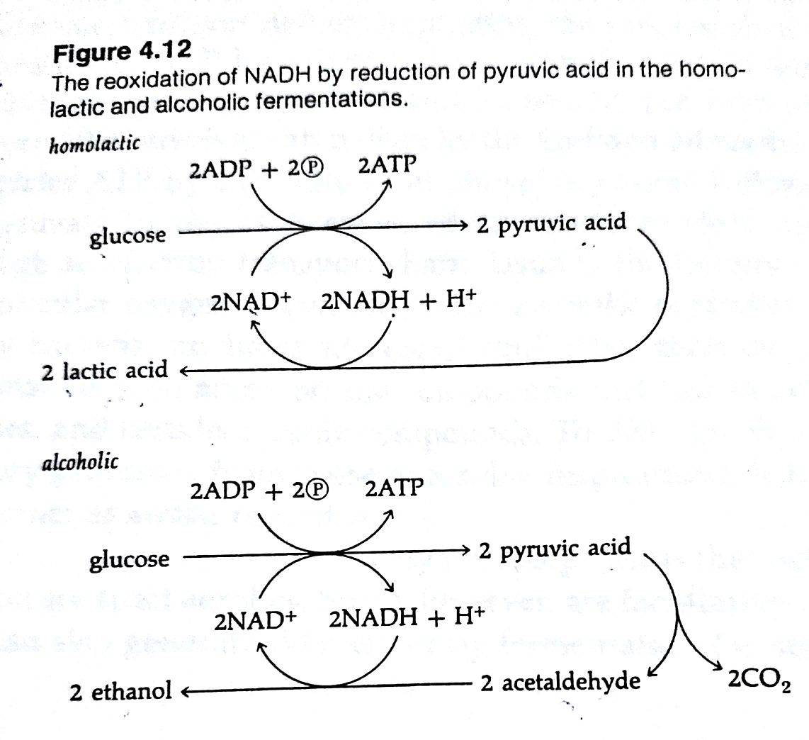

Slide 51
Photosynthesis & Photophosphorylation
Photosynthesis is the process by which plants & certain bacteria (Phototrophs) converts radiant (light) energy in to metabolic energy & reducing power.
Photosynthetic structure in plant – Chloroplast.
In bacteria- chromatophore.
General equation for photosynthesis :
CO2 + H2O → O2 + (CH2O)
In plants it is H2O , in bacteria – H2S or organic compounds.
Different types of reactions in Bacterial Photosynthesis:
  Purple Sulphur Bacteria e.g. Chromatium utilize H2S.
  2H2S + CO2 → C(H2O) + 2S + H2O
  - Purple Sulphur Bacteria utilize Thiosulphate as reductant.

Slide 52
2CO2 + Na2S2O3 + 5H2O → 2C(H2O) + 2H2O + 2NaHSO4
- Non sulphur bacteria e.g.- Rhodosprillum rubrum utilizes
organic compounds like ethanol, isopropanol or succinate.
CO2 + 3 C2H5OH → 2C(H2O) + H2O + CH3CHO
- Purple and green sulphur bacteria carry out anoxygenic photosynthesis.
Photosynthetic Appratus – consist of Three components.
1. An antenna of light harvesting pigments.
2. A photosynthetic Reaction Centre
3. ETC
I. An antenna of light harvesting pigments :
Light harvesting pigments include : Chlorophylls, Carotenoids, Phycobiliproteins.
- Chlorophylls- Plays two roles in photosynthesis - as a light harvesting pigment and as light harvesting pigment.
- Carotenoids & Phycobiliproteins function only as light harvesting pigment.

Slide 53
Chlorophylls :
- Seven kinds occur in various groups of Phototroph.
- Absorb light intensity in two regions – Violet around 400 nm and red or infrared around 600 to 1000nm.
- Resemble hemes.
- Contain four pyrrole ring which are linked to gather by methane bridge.
- In bacteria - chlorophylls are Bacteriochlorophylls - a, b, c, & d. Also contain small amounts of Pheophytins or Bacteriopheophytins(BChl that lack Mg⁺).
- play a special role as ē carriers.
Carotenoids :
- Found in almost all photosynthetic organisms.
- Yellow and orange pigment- soluble inorganic solvents.

Slide 54
- Two types – Carotenes & Carotenols.
Carotenes – e.g. β – carotene , are hydrocarbon .
- present in photosystem- I.
Carotenols (Xanthophylls) are alcohols. Present in photosystem – II.
- Carotenods have single region of absorption between 450 & 550 nm.
Phycobiliproteins :
- are water soluble chromoproteins, contain tetrapyrrols.
- Region of absorption is between 550 & 650 nm.
- two kinds – Phycocyanins (predominate in Blue Green Bacteria)& Phycoerythrins(Red algae).
II. Photochemical Reaction Center :
- contains the site where a molecule of chlorophyll becomes photoactivated & oxidized by donating ē to a carrier molecule.

Slide 55
- Chlorophyll molecule of reaction center differ from antenna – (1) They are associated with certain proteins which on interaction decreases the energy required for activation.
(2) They are in close proximity with carrier molecule which accept ē from them when activated.
- Energy required to activate a molecule of chlorophyll is designated as P (pigment) in reaction center, by a maximum wavelength of photon.
e.g. the reaction center of purple bacterium that is activated maximally by photons of wavelength 870 nm is designated P870.
Reaction center of Purple bacterium- Rhodobacter sphaeroides , -- contains three polypeptide chain, four bacterioChl. , two bacteriopheophytin , two ubiquinone and one iron molecule.

Slide 56
- Rhodopseudomonas viridis also contains cytochrome subunit with four C –type hemes.
III. Photosynthetic ETC :
Photosynthetic ETC located within Photosynthetic membrane – composed of carrier molecules - cytochromes, quinones and Iron sulfur centers.
- Electron flows through ETC – a proton motive force is generated- used to synthesize ATP by a membrane located ATPsynthase.
ETC :
Hemes in cytochrome subunit of RC → P870 → BChl → ↑ → BP → QA → QB → Cyt- bc1 → Cyt- C2 →
↑ ----------←-----------←-----------←---------- ←---------←------←---------↓

Slide 57
Photophosphorylation :
- Photosynthetic bacteria have relatively simple phototransduction machinery, with one of two general types of reaction center.
- One type (found in purple bacteria) passes electrons through pheophytin (chlorophyll lacking the central Mg2 ion) to a quinone.
- The other (in green sulfur bacteria) passes electrons through a quinone to an iron-sulfur center.
- The photosynthetic machinery in purple bacteria
consists of three basic modules (Fig. ) : a single reaction center (P870), a cytochrome bc1 electron transfer
complex , and an ATP synthase, similar to that of mitochondria.

Slide 58
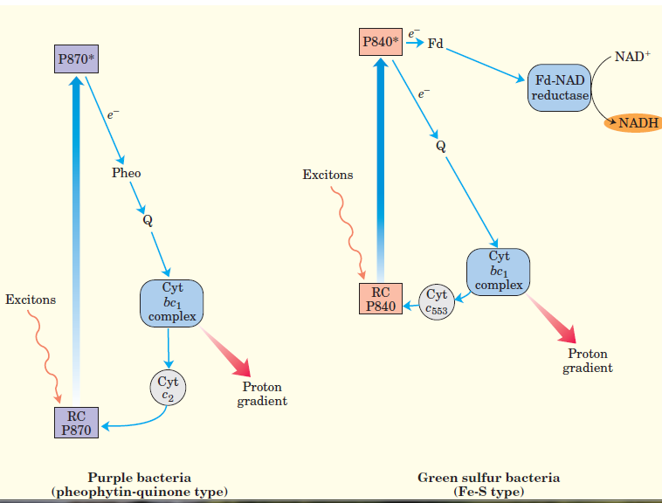

Slide 59
A pair of bacteriochlorophylls— designated (Chl)2—is the site of the initial photochemistry in the bacterial reaction center.
- Energy from a photon absorbed by one of the many antenna chlorophyll molecules surrounding the reaction center reaches (Chl)2 by exciton transfer.
- the energy of the photon, converting the special pair to a very strong electron donor.
- The (Chl)2 donates an electron that passes through a
neighboring chlorophyll monomer to pheophytin (Pheo).
(Chl)2 + 1 exciton → (Chl)2* (excitation)
(Chl)2* + Pheo → (Chl)2 + Pheo⁻ (charge separation)
- The pheophytin radical now passes its electron to a tightly bound molecule of quinone (QA), converting it to a semiquinone radical.

Slide 60
- which immediately donates its extra electron to a second, loosely bound quinone (QB) convert QB to its fully reduced
form, QBH2.
2 Pheo⁻ + 2H⁺ + QB → 2 Pheo + QBH2 (quinone reduction)
- The hydroquinone (QBH2), carrying some of the energy of the photons that excited P870, enters the pool of reduced quinone (QH2) to cytochrome bc1 complex.
- cytochrome bc1 complex using the energy of electron transfer to pump protons across the membrane, producing a protonmotive force.
- Electrons move from the cytochrome bc1 complex to P870 via a soluble cytochrome -c2.
- The electron transfer process completes the cycle, returning the reaction center to its unbleached state, ready to absorb another exciton from antenna chlorophyll.

Slide 61
Photosynthesis in green sulfur bacteria involves the same
three modules as in purple bacteria.
- The process differs with respects to additional enzymatic
reactions (Fig).
- Excitation causes an electron to move from the reaction center to the cytochrome bc1 complex via a quinone carrier.
- Electron transfer through this complex powers proton transport
and creates the proton-motive force used for ATP synthesis, just as in purple bacteria.
- in contrast to the cyclic flow of electrons , some electrons flow from the reaction center to an iron-sulfur protein, ferredoxin, which then passes electrons via ferredoxin:NAD reductase to NAD, producing NADH.
- The electrons taken from the reaction center to reduce NAD are replaced by the oxidation of H2S to elemental S, then to SO4, in the reaction that defines the green sulfur bacteria.

Slide 62
ATP : Structure, Generation & Role :-
- ATP was discovered in muscle extracts by C.Fiske & Y. Subbarow in USA and independently by K. Lohmann in Germany in 1929.
- The structure of ATP was first deduced by K. Lohmann in 1930.
- Derivative of nucleotide Adenosine Mono Phosphate (AMP) or Adenylic acid, to which two additional phosphate groups are linked through pyrophosphate bonds.

Slide 63
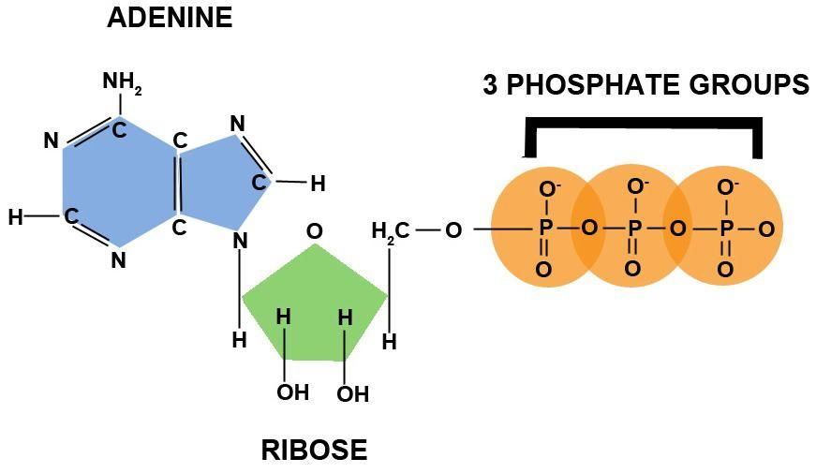
ATP : (Structure, generation & role)
-

Slide 64
- these two bonds are energy rich and their removal by hydrolysis yield ADP & AMP- liberates energy by the transfer of one or both terminal phosphate groups.
e.g. Activation of Glucose :
Glucose + ATP → Glucose-6-P + ADP
Activation of Amino acids :
Amino acid + ATP → AMP- Amino acid + P - P
- AMP is converted to ADP through energy transfer by enzymatic reaction-
AMP + ATP → 2 ADP
- Carrier of free energy is ATP – plays a central role in the transfer of free energy from exergonic to the endergonic (energy requiring) processes in the cell.

Slide 65
Generation of ATP :
Three Mechanisms :
1. Oxidative Phosphorylation
2. Substrate level Phosphorylation
3. PhotoPhosphorylation
Role of ATP :
- Fritz Lipmann- 1941 postulated that - ATP functions in a cyclic manner from degradative reactions which yield energy to the various cellular processes that require energy.
- Drive the entry of nutrients into the cell.
- To convert these nutrients into intermediary metabolites.
e.g. amino acids, sugar- P ,nucleotides, fatty acids.
- Polymerization of intermediates into biopolymers like Proteins, Polysaccharides, N. acids & lipids.

